Slide 1


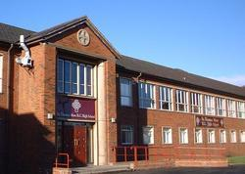


1
Unit 1 Section A
Toward a brighter future for all
FOREIGH LANGUAGE TEACHING AND RESEARCH PRESS
AIR FORCE ENGINEERING UNIVERTISY
Notes:
1

Slide 2
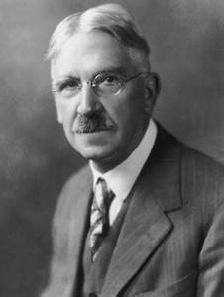
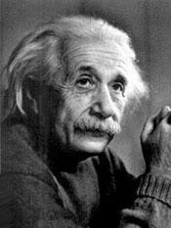
1
1
UNIT
Education is not preparation for life;
Education is life itself.
— John Dewey
Try not to be a man of success,
but rather try to become a man
of value.
— Albert Einstein
Notes:
2

Slide 3

^{Section A}
1
1
Fresh start
UNIT
Toward a brighter future for all
To talk about college education
Objectives
To further understand the text
To apply the phrases and patterns
To master the paragraph writing skill

Slide 4
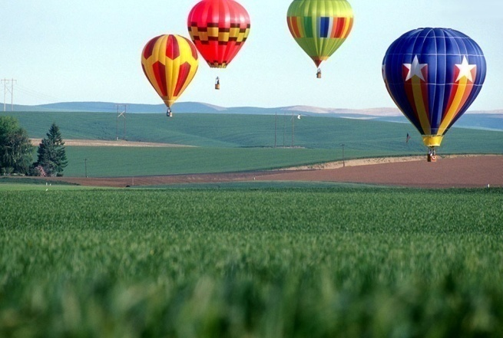


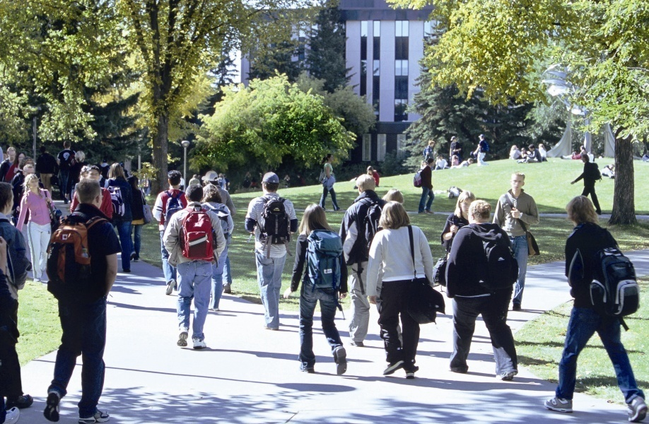


Section A
Toward a brighter future for all
Contents
Warming up activities
Text study
Language application
Summary

Slide 5



Section A
Toward a brighter future for all
Warming up
Lead-in
Pre-reading activities
Cultural background

Slide 6


Short answer questions
1. What is the ideal university like in your eyes?
Tips
Qualified professors
Nice living condition
Excellent environment for teaching and learning
Pleasant academic atmosphere
Well-equipped library and abundant online resources…

Slide 7
Short answer questions
2. What are your expectations of your college life?
Tips
To acquire more knowledge in different aspects
To broaden my horizon and enrich my mind
To develop my creative(critical) thinking ability
To make more new friends
To participate in more social practice

Slide 8

Short answer questions
Listen to an interview about tips for freshman students and do the following exercise.
1. Match the name of the person in the left column with the tip given by the person in the right column.
Name | Tip
1 Jennifer | A keep a balance
2 Mark | B go to class regularly
3 Nancy | C get involved on campus
4 Simon | D find a good place to study
5 Sarah | E take advantage of the study resources on campus
2. What advice did your parents give you before
you left for college?

Slide 9
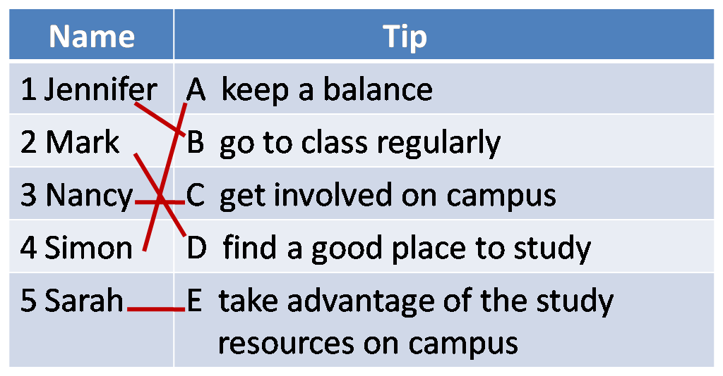

Short answer questions
1. Match the name of the person in the left column with the tip given by the person in the right column.
Tips

Slide 10
Short answer questions
2. What advice did your parents give you before
you left for college?
Tips
Before I left for college they told me :
To cherish the college experience;
To make use of the opportunities for learning;
To develop more interests;
To read as widely as possible.

Slide 11



Compound dictation
Listen to a short passage concerning college education and fill in the missing information.
This is the VOA Special English Education Report.
What is the difference between a college and a university? This is the _________ of part three in our series for students who want to ________ a college or university in the United States.
subject
attend

Slide 12
Compound dictation
Listen to a short passage concerning college education and fill in the missing information.
Colleges and universities have many things in _____________. Both provide a greater ________________ of the world and its past. Both provide education in the arts and sciences. And both can help prepare young people to ____________.
common
understanding
earn a living

Slide 13
Compound dictation
Listen to a short passage concerning college education and fill in the missing information.
Students who complete their _____________ studies either at a for-year college or a university receive ______________ degree. One difference is that many colleges do not offer graduate studies.
undergraduate
bachelor’s

Slide 14
Compound dictation
Listen to a short passage concerning college education and fill in the missing information.
Universities are generally bigger, offer more __________ and do more research. Modern universities developed from those of the ______________ in Europe. The word “university” came from the Latin “universities.” This described a group of people __________ for a common purpose.
programs
Middle Ages
organized

Slide 15

American university education
Questions Previewing
1. In the United States, what choices do the
students have after high school?
2. What are the major criteria for university admission?
3.What kind of extracurricular activities can
students participate in? What can they?

Slide 16


American university education
In the United States, what choices do the
students have after high school?
Tips
go to college;
go straight to the workforce;
attend a two-year community college before applying to a university.

Slide 17

American university education
2. What are the major criteria for university admission?
Tips
A student’s high school course of study;
High school Grade Point Average (GPA);
Participation in extracurricular activities;
SAT or ACT exam scores, a written essay;
A personal interview with a representative from the admissions office.

Slide 18

American university education
3.What kind of extracurricular activities can students participate in? What can they learn?
Tips
The activities include:
Scholastic clubs, athletic teams, student government, and philanthropic (慈善) clubs.
Through their voluntary participation in
these kinds of activities, they can learn:
valuable life lessons, such as teamwork, leadership, or civic (公民) responsibility.

Slide 19


Section A
Toward a brighter future for all
Text study
Main idea & structure
Language focus
Critical thinking

Slide 20


Main ideas of the Parts
The text is __________ made by __________________ to _________________. (Para.1)
a speech
a university president
the freshmen
According to the speaker, of what did the parents always remind their children before they came to college? (Para.3)
Tips
Work hard and attain their best.

Slide 21
Main ideas of the Parts
What’s the speaker’s purpose in mentioning the parents’ reminders? (Para.3)
Tips
Help the students realize that the future is built on a strong foundation of the past.
Notes:
21

Slide 22

Main ideas of the Parts
Part I (Paras. 1- __)
3
The president congratulates students on their achievement and reminds students of the fact that their current success was due to _________________________________, and that their future is built on __________________________________.
their own and their parents’ efforts
a solid foundation of the past

Slide 23


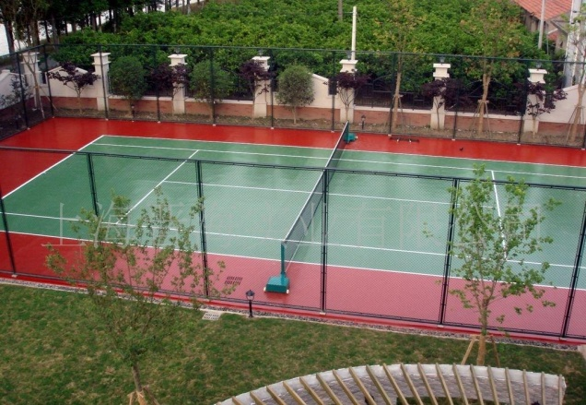

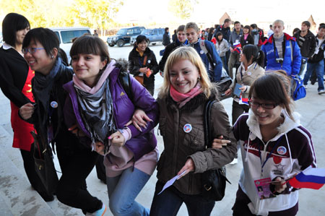

Main ideas of the Parts
How will the next four years be different from any other? Or what great resources will you enjoy ? (Para.4)
a comprehensive library
a learned and caring faculty
great sports facilities
make the most of this unique experience
Great
resources
Interesting students
student organizations
Notes:
23

Slide 24
Main ideas of the Parts
The wealth of courses (Para. 5)
Advice?
Sample them widely!
Challenge yourself!
a more broadly educated person;
a better chance at …
Possible benefits?

Slide 25

Main ideas of the Parts
Para. 6
Unpleasant experience
Here at the university, it may not always be _________ to have so many new experiences all at once. In your dorm, the student next door may ______________ play the one song, which gives you a giant headache! You may be an early bird while your roommate is ______________! And still, you and your roommate may become best friends. Don’t worry if you become a little uncomfortable with some of your new experiences.
pleasant
repeatedly
a night owl

Slide 26
Main ideas of the Parts
Para. 6
I promise you that the happy experiences will ___________ the unpleasant ones. And I promise that virtually all of them will provide you with valuable lessons which will _________________. So, with a glow in your eye and ____________________,
step forward to _____________________
____________________!
outweigh
enrich your life
a song in your heart
meet these new
experiences
advice

Slide 27

Main ideas of the Parts
What responsibilities should college students shoulder according to the speaker? (Para.7)
Tips
acquire knowledge;
discover passion;
build a strong and prosperous future for the later generations.
Notes:
27

Slide 28
Main ideas of the Parts
Part II (Paras. 4-7)
The president offers students comprehensive advice on how ________________________________________ and makes them realize the university’s _______________ and their own ___________________.
to make the most of their four college years
expectations
responsibilities

Slide 29
Main ideas of the Parts
What does the speaker call on students to do at the end of his speech? (Para.8)
Tips
To carry their responsibilities as citizens of their communities, their country and the world.
Notes:
29

Slide 30
Main ideas of the Parts
Para. II (Para. 8)
The students are called upon to _____________________ and to ____________ their _____________ as citizens of their communities, their country and the world.
cherish the opportunity
bear in mind
responsibilities

Slide 31
Main ideas of the Parts
In his welcome speech, the president urges students to ____________________ ________________________________ to _________________________________, and to _______________________ so that they will reap the benefits of their college years. The president also expresses the university’s _____________ of its students and of the __________________ they carry.
take advantage
of the unique opportunity
face new exciting experience
challenge themselves
expectations
responsibilities

Slide 32
Structure of the text
Opening part of the welcome speech
The president congratulates
college freshmen for entering
a new phase in life. (Para. 1)
The president recalls an
event when he graduated
from high school. (Para. 2)
The president reminds students
that their future success is built on a solid foundation of the past. (Para. 3)

Slide 33
Structure of the text
Opening part
Advice
Make the
best of
what you
have.
(Para. 4)
Challenge
yourself.
(Para. 5)
Meet new
experiences.
(Para. 6)
Carry your
responsibi-lities.
(Para. 7)

Slide 34
Structure of the text
Opening part
Advice
Students are called upon to cherish the opportunities, and to keep in mind their responsibilities. (Para. 8)

Slide 35
Structure of the text
Opening part
Advice
Concluding part

Slide 36
Summary of the text
Toward a Brighter Future for All
Good afternoon! As president of the university, I am proud to ___________ you to this university. Your current achievement is the __________ of years of hard work. Here, you may encounter things you do not expect. But remember: Your future success is built on a solid ____________ of the past.
welcome
triumph
foundation

Slide 37
Summary of the text
For you, the next four years will be a time unlike any other. You are provided with great ___________ and the freedom to explore new subjects and ________ new passions. What you need to do is to _________________ this unique experience, and to use your energy and enthusiasm to ______________ of this opportunity. You may also feel _____________ by the wealth of courses available. My advice is:
resources
pursue
make the most of
reap the benefits
overwhelmed

Slide 38
Summary of the text
____________ yourself! You should _______ new subjects, cultivate new interests, and pursue new passions. Besides, there also may be many _____________ experiences as well as pleasant ones here at the university. But the latter will ___________ the former. All of them will become valuable lessons to _______ your lives. So, get ready to meet these new experiences optimistically. At last, with ______________ opportunities
Challenge
sample
unpleasant
outweigh
enrich
overwhelmed

Slide 39
Summary of the text
responsibilities
there also come _________________. You should bear the expectations and responsibilities as you __________ and pass on the spirit of hard work, and _________ and transmit knowledge.
We take ___________ in the many opportunities you will find here and in the responsibilities you will carry as __________ of your communities, your country, and the world. Welcome!
inherit
acquire
pleasure
citizens

Slide 40

Practical Phrases
Practical Phrases | Specific Meanings
1. pledge to do sth. | 作保证，承诺
2. make the most of sth. | 充分利用
3. reap the benefits | 得享好处
4. feel overwhelmed by sth. | 因……无法对付
5. stand chance of | 有机会，有希望
6. take great pleasure in doing sth. | 乐于做某事
7. open the door to sth. | 给……打开方便之门

Slide 41

Practical Phrases
作保证，承诺
短语逆译
pledge to do sth.
短语应用
中美政府承诺将加强合作与交流以确保两国关系的未来更加美好。
意群提示
(pledge to /boost cooperation/exchange/China-US ties )
China and the United states pledge to boost cooperation and exchange to ensure a better future for China-US ties.

Slide 42
Practical Phrases
充分利用
短语逆译
to make the most of
短语应用
这篇文章向你介绍iPhone5S手机的7个使用小窍门。
意群提示
(tips / to make the most of)
This article introduces 7 tips for making the most of your iPhone5S.

Slide 43
Practical Phrases
to reap the benefits
受益，得享好处
短语逆译
短语应用
继续广泛阅读，你会受益的。
意群提示
(read extensively / to reap the benefits / sooner or later)
Keep on reading extensively, and you will reap the benefits sooner or later.

Slide 44
Practical Phrases
to feel overwhelmed by
不知所措
短语逆译
短语应用
现如今，激烈的竞争让许多年轻人不知所措。
意群提示
(fierce competition / feel overwhelmed / job market)
Nowadays, many young people feel overwhelmed by the fierce competition in the job market.

Slide 45
Practical Phrases
有机会，有希望
短语逆译
to stand a chance of
短语应用
在这种极端天气下动物很难存活。
意群提示
(stand little chance of / extreme weather)
Animals stand little chance of survival under such extreme weather.

Slide 46
Practical Phrases
to take pleasure in doing sth.
乐于做某事
短语逆译
短语应用
他总是乐于向周围的人伸出援助之手。
意群提示
He always takes great pleasure in lending a helping hand to people around him.
(take a great pleasure in / lend a helping had)

Slide 47
Practical Phrases
to open the door to sth.
打开方便之门
短语逆译
短语应用
这些实用的建议为你更好地与父母交流敞开方便之门。
意群提示
(open the door to / communicate with)
These useful suggestions open the door to better communication with your parents.

Slide 48
Functional patterns
Functional Patterns | Functions & Usages
1. As …, sb. is proud /happy/ sorry /sad… to do sth. | 用于表达“某人在特定身份下做某事的感受”。
2. In doing sth, sb. is reminded of sth. | 用于表达“某事引起的回忆”。
3. If sb. could give sb. else only one piece of advice about…, it would be this: Do sth.! | 用于表达“某人认定的最为重要的建议”。
4. … A wonderful example of this is sb. who…/ sth. that… | 用于列举“最典型的事例”。
Notes:
48

Slide 49

Functional patterns
原句译文
作为校长，我非常自豪地欢迎你们来到这所大学。
逆译练习
As president of the university, I am proud to welcome you to this university.
句型提炼
Notes:
49

Slide 50
Functional patterns
句型提炼
As …, sb. is proud /happy/ sorry /sad… to do sth.
应用提示
用于表达“某人在特定身份下做某事的感受”。
句型应用
Notes:
50

Slide 51
Functional patterns
典型例句
作为一名来自灾区的学生代表，我非常感激社会各界对我们的关爱与帮助！
意群提示
( disaster-hit area / be grateful / all walks of life)
As a student representative from the disaster-hit area, I’m very grateful to the people of all walks of life for their care and help!

Slide 52
Functional patterns
原句译文
在欢迎你们到来的这一刻，我想起自己高中毕业时的情景，还有妈妈为我和爸爸拍的合影。
逆译练习
In welcoming you to the university, I am reminded of my own high school graduation and the photograph my mom took of my dad and me.
句型提炼
Notes:
52

Slide 53
Functional patterns
句型提炼
In doing sth, sb. is reminded of sth.
应用提示
用于表达“某事引起的回忆”。
句型应用
Notes:
53

Slide 54
Functional patterns
典型例句
第一次给这么多人做演讲时，我想起我的英语老师给我的鼓励和建议。
意群提示
(make speech / be reminded of / encouragement )
In making my speech in front of a large audience, I’m reminded of the encouragement and advice from my English teacher.

Slide 55
Functional patterns
原句译文
如果我只能给你们一条选课建议的话，那就是：挑战自己！
逆译练习
If I could give you only one piece of advice about selecting courses, it would be this: Challenge yourself!
句型提炼
Notes:
55

Slide 56
Functional patterns
句型提炼
If sb. could give sb. else only one piece of advice about…, it would be this: Do sth.!
应用提示
用于表达“某人认定的最为重要的建议”。
句型应用
Notes:
56

Slide 57
Functional patterns
典型例句
如果让我给你一条如何应对大学挑战的建议，那就是：相信自己！
意群提示
(cope with / believe in yourself)
If I could give you only one piece of advice about how to cope with the college challenges, it would be this: Believe in yourself!

Slide 58
Functional patterns
原句译文
一个绝佳的例子就是时装设计师王薇薇。她最初学的是艺术史。
逆译练习
A wonderful example of this is the fashion designer, Vera Wang, who originally studied art history.
句型提炼
Notes:
58

Slide 59
Functional patterns
句型提炼
A wonderful example of this is sb. who…/ sth. that…
应用提示
用于列举“最典型的事例”。
句型应用
Notes:
59

Slide 60
Functional patterns
典型例句
有些人没有大学文凭也获得了成功。一个绝佳的例子就是微软公司创始人比尔•盖茨，他在大三时就从哈佛退学了。
意群提示
(college diploma/ wonderful example/ drop out of )
Some people achieved great success even though they did not have college diplomas. A wonderful example of this is the founder of Microsoft, Bill Gates, who dropped out of Harvard in his junior year.

Slide 61


Language appreciation
你们所取得的成就是你们自己多年努力的结果，也是你们的父母和老师们多年努力的结果。
a. Your achievement is the triumph of years of hard work, both of your own and of your parents and teachers. (Para.1, L2)

Slide 62
Language appreciation
但是要记住：未来是建立在过去扎实的基础上的。
b. But know this: The future is built on a strong foundation of the past. (Para.3, L4)

Slide 63
Language appreciation
这样，你不仅会变得更加博学，而且更有可能发现一个你未曾想到的、能成就你未来的爱好。
c. You will not only emerge as a more broadly educated person, but you will also stand a better chance of discovering an unsuspected passion that will help to shape your future. (Para.5, L6)

Slide 64
Language appreciation
带着热切的目光、欢乐的心情，勇敢向前去拥抱这些新的体验吧！
d. With a glow in your eye and a song in your heart, step forward to meet these new experiences! (Para.6, L8)

Slide 65
Language appreciation
教育代代相传，它就是社会的灵魂。
e. Education is simple the soul of a society as it passes from one generation to another. (Para.7, L5)

Slide 66

Theme exploration
Do you think a university education can change a person’s life? In what way and why?
How do you think of those successful people such as Bill Gates who dropped out of university?
What are you going to do at university in order to sample widely and challenge yourself?

Slide 67

Theme exploration
Do you think a university education can change a person’s life? In what way and why?
Tips
Yes, absolutely. With a university education,
a person will have more freedom and therefore more choices. This education experience provides unlimited potentials. Moreover, a university education provides the means for one to succeed. Not only will a person obtain knowledge and skills essential for career development, but he will also develop an independent mind and be able to make right decisions on his own.

Slide 68
Theme exploration
2. What do you think of those successful people such as Bill Gates who dropped out of university?
\\
Tips
I admire those who drop out of university and yet have made fame for themselves by achieving big goals. Some people use those successful college drop outs as counterexamples to show their belief that a person can succeed even without a university education. Chances are that most people do not have the same mind, talent, determination, or opportunities as Bill Gates, Steve Jobs, and Mark Zuckerberg did; therefore, they might not be able to achieve success without having a university education. In fact, a university education equip themselves with the necessary knowledge and skills which help them to succeed.

Slide 69
Theme exploration
3. What are you going to do at university in order to sample widely and challenge yourself?
Tips
To sample widely and challenge myself, I am going to venture out of my comfort zone and do what I have not had the courage to do. For instance, I will make friends with people from diverse backgrounds and cultures. I will take a swimming class and learn how to swim. I will attend unconventional lectures, join student clubs, and try all kinds of food. Most of all, I will do whatever it takes to make the most of the four years and try to become a well-rounded graduate.

Slide 70


Section A
Toward a brighter future for all
Language application
Writing devices
Oral reproduction
Paragraph translation

Slide 71

Sentence writing
Parallelism：
By placing two or more ideas of equal value in the same grammatical form enables us to express these ideas clearly and emphatically.
Example:
You may have cried tears of joy to be finally finished with high school; your parents may have cried tears of joy to be finally finished with doing your laundry!

Slide 72
Sentence writing
Appreciation
I have a dream that my four children will one day live in a nation where they will not be judged by the color of their skin but by the content of their character.
I have a dream that one day every valley shall be exalted, every hill and mountain shall be made low, the rough places will be made plain, and the crooked places will be made straight, and the glory of the Lord shall be revealed, and flesh shall see it together.
我梦想有一天，我的四个孩子将生活在 一个不是以皮肤的颜色，而是以品格的优劣作为评判标准的国家。
我梦想有一天，深谷弥合，高山夷平，歧路化坦途，曲径成通衢，上帝的光华再现，普天下生灵共谒。

Slide 73
Sentence writing
Practice
If he did, I am sorry I never told him（我是多么对不起他，我是个多么不孝敬的儿子，我是多么后悔）____________________________________________.
how sorry I was, how unworthy I was, how I regretted it
I think of them (每当我因为一些琐事而怨天尤人的时候，每当我嫉妒别人运气比我好的时候，每当我没有一颗“好心”的时候) ____________________________________ ____________________________________ _______________________________.
when I complain about trifles, when I am
envious of another’s good fortune,
when I don’t have a “good heart”

Slide 74
Paragraph writing
Topic
Details
Conclusion

Slide 75
Paragraph writing
Example:
For you, these next four years will be a time unlike any other. (Topic sentence) Here you are surrounded by great resources: interesting students from all over the country, a learned and caring faculty, a comprehensive library, great sports facilities, and student organizations covering every possible interest from the arts to science, to community service and so on. (Detail 1: What is available to you on campus)

Slide 76
Paragraph writing
Example:
You will have the freedom to explore and learn about new subjects. You will learn to get by on very little sleep, meet fascinating people, and pursue new passions. (Detail 2: What you can do) I want to encourage you to make the most of this unique experience, and to use your energy and enthusiasm to reap the benefits of this opportunity. (Concluding sentence)

Slide 77

Paragraph writing
Writing practice
Directions: Have a look at the outline below and the sample paragraph, which starts with a topic supported by details.

Slide 78
Paragraph writing
Topic sentence: How to choose a suitable university.
Factor 1: Preparing you for your future
Factor 2:
Affordability
Factor 3:
Good location
• up-to-date
courses
• qualified
professors
• reasonable tuition fees and living expenses
• scholarships
• quiet location
• convenient public transport
Concluding sentence: Consider these points carefully and find the most suitable university.

Slide 79
Paragraph writing
Sample paragraph:
When choosing a university, you must consider some key factors. (Topic sentence) The most important factor is whether the university can prepare you well for your future. It should provide up-to-date courses and have qualified professors. (Detail 1) Another factor is affordability. You need to be able to afford the tuition fees and living expenses. Some schools offer scholarships to outstanding students or to those who cannot afford the
tuition fees. (Detail 2)

Slide 80
Paragraph writing
Sample paragraph:
Finally, a good location is also important. An ideal school should be located in a quiet place and have convenient public transport. (Detail 3) You should consider these factors carefully in order to find the most suitable university. (Concluding sentence)

Slide 81
Paragraph writing
Writing practice
Directions: Write a paragraph on one of the following topics. One of the topics has an outline you can follow.

Slide 82
Paragraph writing
Topic : How to succeed in college
Topic sentence:
There are three things you can do to succeed in college.
Three things to do:
• pursue passions
• seize opportunities
• take responsibilities
Concluding sentence: You will become successful not only in college, but also in your future career.

Slide 83
Paragraph writing
How to succeed in college:
There are some things you can do to succeed in college. (Topic sentence) First, pursue passions. Your passions will broaden your mind and make your life interesting. (Detail 1) Second, never let go of any opportunities that come your way. College is full of unique opportunities, which enable you to sample new things and meet wonderful people. (Detail 2)

Slide 84
Paragraph writing
How to succeed in college:
Lastly, take responsibilities. In college you must learn to be responsible for your own decisions and actions. (Detail 3) With the passions, the opportunities, and the ability to take responsibility, you will become successful not only in college, but also in your future career. (Concluding sentence)

Slide 85
Paragraph writing
More topics:
• How to manage time in college
• How to dealing with stress in college

Slide 86


Speech making
Make a speech on the following topic.
Suppose, as an freshman, you are expected to give a speech to your teachers and classmate.

Slide 87

Speech making
You can follow the outline given below.
Part I Opening part of the speech
1.Your gratitude to your teachers and parents;
2.Your feelings and impressions about the
university;
3.Your expectation of the future.

Slide 88
Speech making
You can follow the outline given below.
Part II Your understanding of the university
1. School motto and your interpretation;
2. Campus facility, e.g. the library, and
learning atmosphere;
3. Courses and other social activities;
4. Teachers and classmates.
Part III Conclusion
1. Opportunities and challenges;
2. Your plans and determination for the future.

Slide 89
Speech making
You may adopt the following expressions.
on behalf of sb.
to be grateful to do sth.;
not to live up to one’s expectations;
a time of self enrichment and self-discovery
to make sth. as rewarding as possible;
to pursue one’s own passions;
to shoulder the responsibilities as

Slide 90


Translate a paragraph based on a summary of the text by using the expressions from the text.

Slide 91
在你们人生的新旅途上，我觉得有必要提醒大家进入大学是你们昨天努力的结果。未来四年，我希望你们能充分利用综合图书馆、运动设施、教师等成功所需的丰富资源。虽然众多课程和宿舍生活也会让人不知所措，但我认为新鲜独特的
remind
triumph of hard work
make the use of
abundant resources
feel overwhelmed by

Slide 92
经历会远远多于令人不快的经历，并能帮你收获未来生活所需的宝贵经验。我相信只要你们乐意挑战自我，把激情和责任结合起来，就一定能为自己的未来打下坚实的基础。
overweigh
reap
take pleasure in
pair ... with
build a strong
foundation

Slide 93
In your new journey of life, I feel it necessary to remind you that entering university is the triumph of your past hard work. In the future four years, I expect you to make the most of comprehensive library, sports facilities, faculty members and other abundant resources that success needs. Although you may feel overwhelmed by wealth of courses and dorm life, I assume that the new unique experiences far overweigh uncomfortable ones and they will help you reap the valuable lessons that you need in the future life. I believe as long as you take pleasure in challenging yourself and pairing passion with responsibilities, you can build a strong foundation for your future.

Slide 94



Section A
Toward a brighter future for all
Summary
Revision of
the useful expressions
Thematic study
Revision of
the functional patterns

Slide 95

Language points — useful expressions
1 多年努力的结果
2 使你学有所成
3 取得佳绩
4 喜极而泣
5 无与伦比的时光
6 追求心的爱好
7 变得更加博学
8 令人头痛欲裂
9 早起的人
10 夜猫子
the triumph of years of hard work
make your educational experience as rewarding as possible
attain one’s best
cry tears of joy
a time unlike any other
pursue new passions
emerge as a more broadly educated person
give sb. a giant headache
an early bird
a night owl

Slide 96
Language points — useful expressions
11 快乐的经历多于令人不快的经历
12 使生活丰富多彩
13 带着热切的目光
14 代代相传
15 艰苦努力的传承者
16 获取、传递知识
17创造强大昌盛的未来
18 承担起……的责任
19 铸就未来
20 大量机会
the happy experiences outweigh the unpleasant ones
enrich one’s life
with a glow in one’s eye
pass from one generation to the next
inheritors of the hard work
acquire and transmit knowledge
build a strong and prosperous future
carry the responsibilities as …
shape one’s future
abundant opportunities

Slide 97
Language points — useful expressions
Functions & Usages | Sentence Patterns
用于表达“某人在特定 身份下做某事的感受”。
2. 用于表达“某事引 起的回忆”。
3. 用于表达“某人认 定的最为重要的建议”。
4. 用于列举“最典型的事 例”。
As …, sb. is proud /happy/
sorry /sad… to do sth.
In doing sth, sb. is reminded
of sth.
If sb. could give sb. else only
one piece of advice about…,
it would be this: Do sth.!
… A wonderful example of this is sb. who…/ sth. that…
Notes:
上面挤，下面空

Slide 98
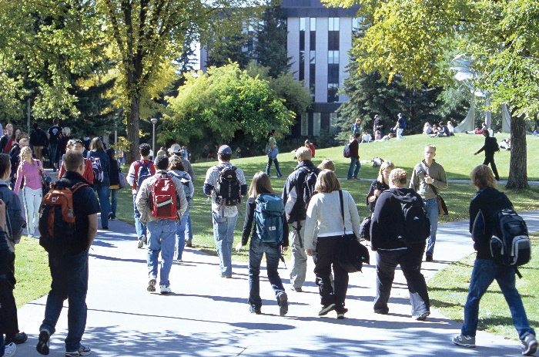

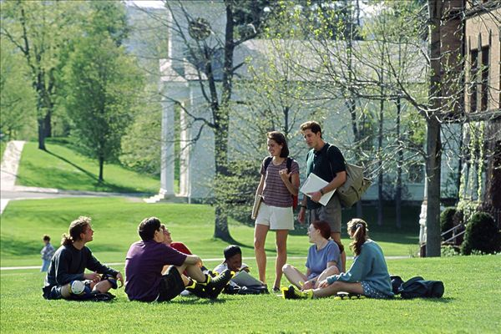
Section A
Toward a brighter future for all
The end

